Slide 1
Process Synchronization
Hamid R. Zarandi
h_zarandi@aut.ac.ir

Slide 2
Motivation
Cooperating process/thread:
the one that can affect or be affected by other processes executing in system.
Processes, threads
Processes can execute concurrently
May be interrupted at any time, partially completing execution
Problem: Data inconsistency
It may occur in the case of concurrent access to shared data
How to solve?
Orderly execution of cooperating processes that share a logical address space

Slide 3
One example!
A solution to consumer-producer problem that fills all the buffers.
We can have an integer counter that keeps track of the number of full buffers.
Initially, counter is set to 0.
It is incremented by the producer after it produces a new buffer
It is decremented by the consumer after it consumes a buffer.

Slide 4
Circular buffer & producer-consumer problem
#define BUFFER_SIZE 10
typedef struct {
. . .
} item;
item buffer[BUFFER_SIZE];
int in = 0;
int out = 0;
Producer
Consumer
item next_produced;
while (true) {
/* produce an item in next produced */
while (counter == BUFFER_SIZE))
; /* do nothing */
buffer[in] = next_produced;
in = (in + 1) % BUFFER_SIZE;
counter ++;
}
item next_consumed;
while (true) { while (counter == 0)
;/* do nothing */
next_consumed = buffer[out];
out = (out + 1) % BUFFER_SIZE; counter --;
/* consume the item in next consumed */
}

Slide 5

Race condition
counter++ could be implemented as register1 = counter MOV AX, [100] register1 = register1 + 1 ADD AX, 1 counter = register1 MOV [100], AX
counter-- could be implemented as register2 = counter MOV BX, [100] register2 = register2 – 1 ADD BX, 1 counter = register2 MOV [100], BX
Consider this execution interleaving with “count = 5” initially:
S0: producer execute register1 = counter {register1 = 5} S1: producer execute register1 = register1 + 1 {register1 = 6} S2: consumer execute register2 = counter {register2 = 5} S3: consumer execute register2 = register2 – 1 {register2 = 4} S4: producer execute counter = register1 {counter = 6 } S5: consumer execute counter = register2 {counter = 4}

Slide 6
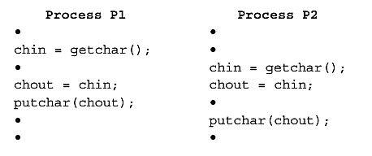
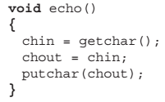
Another Race condition
Invoking echo() procedure:
Same problem exists on:
Multiprogramming environment
Multiprocessing environment
Distributed processing environment

Slide 7
Other examples?
Have you ever seen other examples?

Slide 8
Definition
Race condition
Several process access and manipulate the same data concurrently
Outcomes of the execution depends on the order in which the access take place
How to remove Race Condition?
Serial execution

Slide 9
Critical Section Problem

Slide 10
Critical section problem
Consider system of n processes {p₀, p₁, … p_{n-1}}
Each process has critical section segment of code
Process may be changing common variables, updating table, writing file, etc
When one process in critical section, no other may be in its critical section
Critical section problem is to design protocol to solve this
Each process must ask permission to enter critical section in entry section, may follow critical section with exit section, then remainder section

Slide 11
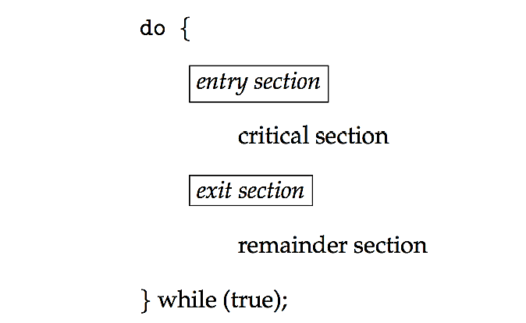
Critical section
General structure of process P_{i}

Slide 12
Requirements to solutions
Mutual exclusion
If process P_{i} is executing in its critical section, then no other processes can be executing in their critical sections
Progress
If no process is executing in its critical section and there exist some processes that wish to enter their critical section, then the selection of the processes that will enter the critical section next cannot be postponed indefinitely
Bounded waiting
A bound must exist on the number of times that other processes are allowed to enter their critical sections after a process has made a request to enter its critical section and before that request is granted
Assume that each process executes at a nonzero speed
No assumption concerning relative speed of the n processes

Slide 13
Preemption definition
Preemption
The act of temporarily interrupting a task being carried out by a computer system, without requiring its cooperation, and with the intention of resuming the task at a later time [wiki]

Slide 14
Handling critical-section by OS
Two approaches, depend on type of OS kernels
Preemptive
Allows preemption of process when running in kernel mode
Difficult to design in SMP architectures (why?)
Non-preemptive
Runs until exits kernel mode, blocks, or voluntarily yields CPU
Essentially free of race conditions in kernel mode (why?)
Which one
is responsive?
is suitable for real-time programming?

Slide 15
1) Peterson’s solution
A classis SW solution
No guarantees in correct working of the method
Correctness depends on computer architecture
Atomic instructions are needed (which & where?)
Good algorithm!
Shared variables
int turn; /* whose turn is */
Boolean flag[2] /* who enters the critical-section */

Slide 16
Peterson algorithm for P_{i}
(Pi, Pj)=(P0, P1)
do {
flag[i] = true;
turn = j;
while (flag[j] && turn = = j);
critical section
flag[i] = false;
remainder section
} while (true);
How requirements are satisfied?
Mutual exclusion (?)
Progress (?)
Bounded waiting (?)

Slide 17
2) Hardware solution
Some hardwares support implementing the critical section code!
All solutions are based on idea of locking
Protecting critical regions via locks
Uniprocessors – could disable interrupts
Currently running code would execute without preemption
Generally too inefficient on multiprocessor systems
Operating systems using this not broadly scalable
Multiprocessors – provide special atomic hardware instructions
Atomic = non-interruptible
Either
test memory word and set value
swap contents of two memory words

Slide 18
Hardware solution for critical section
How requirements are satisfied?
Mutual exclusion (?)
Progress (?)
Bounded waiting (?)
do {
acquire lock
critical section
release lock
remainder section
} while (TRUE);

Slide 19
test_and_set instruction
Definition:
boolean test_and_set (boolean *target)
{
boolean rv = *target;
*target = TRUE;
return rv; /* old value */
}
Executed atomically
Returns the original value of passed parameter
Set the new value of passed parameter to “TRUE”.

Slide 20
Hardware solution using test_and_set()
Shared Boolean variable lock, initialized to FALSE
do { while (test_and_set(&lock))
; /* do nothing */
/* critical section */
lock = false;
/* remainder section */
} while (true);

Slide 21
compare_and_swap instruction
Definition:
int compare _and_swap(int *value, int expected, int new_value) {
int temp = *value;
if (*value == expected)
*value = new_value;
return temp; /* old value */
}
Executed atomically
Returns the original value of passed parameter “value”
Set the variable “value” the value of the passed parameter “new_value” but only if “value” ==“expected”. That is, the swap takes place only under this condition.

Slide 22
Hardware solution using compare_and_swap()
Shared integer “lock” initialized to 0;
do { while (compare_and_swap(&lock, 0, 1) != 0)
; /* do nothing */
/* critical section */
lock = 0;
/* remainder section */
} while (true);
How requirements are satisfied?
Mutual exclusion (?)
Progress (?)
Bounded waiting (?)

Slide 23
Bounded-waiting mutual exclusion with test_and_set
do { waiting[i] = true; key = true; while (waiting[i] && key)
key = test_and_set(&lock);
waiting[i] = false;
/* critical section */
j = (i + 1) % n;
while ((j != i) && !waiting[j])
j = (j + 1) % n;
if (j == i)
lock = false;
else
waiting[j] = false;
/* remainder section */
} while (true);

Slide 24
3) OS solution!: Mutex locks
Previous solutions are complicated and generally inaccessible to application programmers
OS designers build software tools to solve critical section problem
Simplest is mutex lock (mutual exclusions)
Protect a critical section by first acquire() a lock then release() the lock
Boolean variable indicating if lock is available or not
Calls to acquire() and release() must be atomic
Usually implemented via hardware atomic instructions
But this solution requires busy waiting
This lock therefore called a spinlock

Slide 25
acquire() and release()
acquire() { while (!available)
; /* busy wait */
available = false;;
}
release() {
available = true;
}
do {
acquire lock
critical section
release lock
remainder section
} while (true);
How requirements are satisfied?
Mutual exclusion (?)
Progress (?)
Bounded waiting (?)

Slide 26
What is the main problem of all mentioned methods?
Busy waiting!

Slide 27
4) Semaphore
Synchronization tool that provides more sophisticated ways (than Mutex locks) for process to synchronize their activities
Semaphore S – integer variable
Can only be accessed via two indivisible (atomic) operations
wait()and signal()
wait(S)
{
while (S <= 0)
; // busy wait
S--;
}
signal(S)
{
S++;
}

Slide 28
No busy waiting in Semaphore
Have a FIFO queue for waiting process
typedef struct{
int value;
struct process *list;
} semaphore;
wait(semaphore *S) {
S->value--;
if (S->value < 0) { add this process to S->list;
block();
}
}
signal(semaphore *S) {
S->value++;
if (S->value <= 0) { remove a process P from S->list;
wakeup(P);
}
}

Slide 29
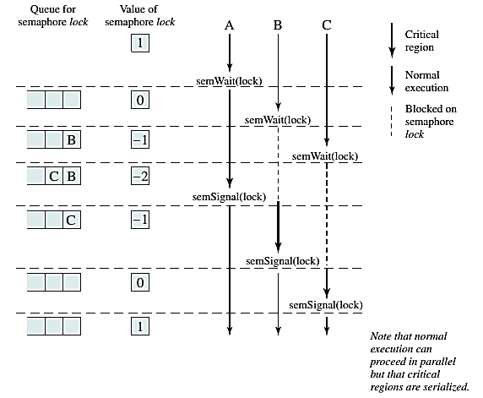
Accessing shared data by Semaphore

Slide 30
Types of semaphore
Types
Binary semaphore (same as mutex lock)
Counting semaphore (suitable for managing number of resources)
Can solve various synchronization problems
Example:
Consider P₁ and P₂ that require S₁ to happen before S₂
Create a semaphore “synch” initialized to zero
P1:
S₁;
signal(synch);
P2:
wait(synch);
S₂;

Slide 31
Semaphore points
Must guarantee that no two processes can execute the wait()and signal()on the same semaphore at the same time (why?)
wait() and signal() must be atomic!
wait() and signal() generate a Critical Section Problem!
How to solve?
Uniprocessors
Disabling interrupts
SMP (Multiprocessors)
Disabling interrupts (bad performance effect)
Other methods: compare_and_swap() and spinlock (is it good to have busy waiting?)

Slide 32
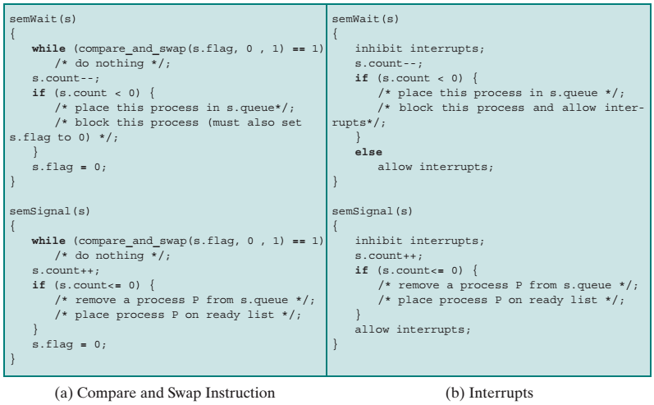
Two implementations of semaphores

Slide 33
Problems with semaphores
Be careful in the usage
Deadlock, Starvation, Priority inversion
Starvation
LIFO queue
Priority Inversion – Scheduling problem when lower-priority process holds a lock needed by higher-priority process
Example: L (R) < M < H (R)
Solved via priority-inheritance protocol
P₀
wait(S);
wait(Q);
...
signal(S);
signal(Q);
P₁
wait(Q);
wait(S);
...
signal(Q);
signal(S);

Slide 34
Classic synchronization problems
The bounded-buffer problem
The readers-writers problem
The dining-philosophers problem
How can semaphore solve these problems?

Slide 35
The bounded-buffer problem
int n;
semaphore mutext = 1;
semaphore empty = n;
semaphore full = 0;
Producer
Consumer
do {
... /* produce an item in next_produced */
...
wait(empty);
wait(mutex);
...
/* add next produced to the buffer */
...
signal(mutex);
signal(full);
} while (true);
do {
wait(full);
wait(mutex);
...
/* remove an item from buffer to next_consumed */
...
signal(mutex);
signal(empty);
...
/* consume the item in next consumed */
...
} while (true);

Slide 36
The readers-writers problem
semaphore rw_mutex = 1;
semaphore mutex = n;
int read_count = 0;
Readers
Writers
do { wait(mutex); read_count++; if (read_count == 1)
wait(rw_mutex);
signal(mutex);
...
/* reading is performed */
...
wait(mutex); read count--; if (read_count == 0)
signal(rw_mutex);
signal(mutex);
} while (true);
do { wait(rw_mutex);
...
/* writing is performed */
...
signal(rw_mutex);
} while (true);

Slide 37
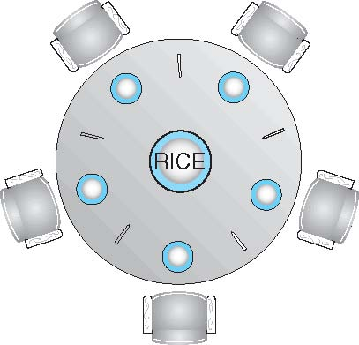
The dining-philosophers problem
Thinking and eating alternatively
semaphore chopstick[5];
do {
wait (chopstick[i] );
wait (chopStick[ (i + 1) % 5] );
// eat
signal (chopstick[i] );
signal (chopstick[ (i + 1) % 5] );
// think
} while (TRUE);
Any problem?

Slide 38
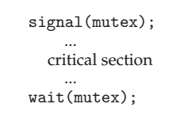
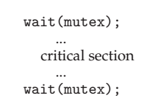
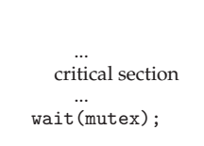
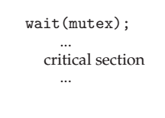
Other problems with semaphore
Problems with bad usage
Deadlock and starvation are possible.

Slide 39
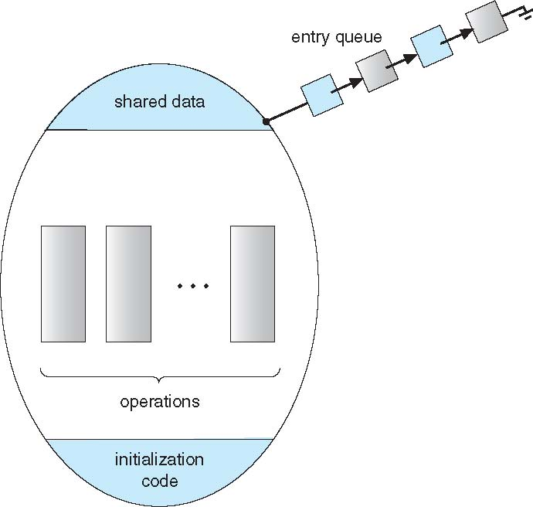
5) Monitor
A high-level abstraction that provides a convenient and effective mechanism for process synchronization
Only one process may be active within the monitor at a time
monitor monitor-name
{
// shared variable declarations
procedure P1 (…) { …. }
procedure Pn (…) {……}
Initialization_Code (…) { … }
}

Slide 40
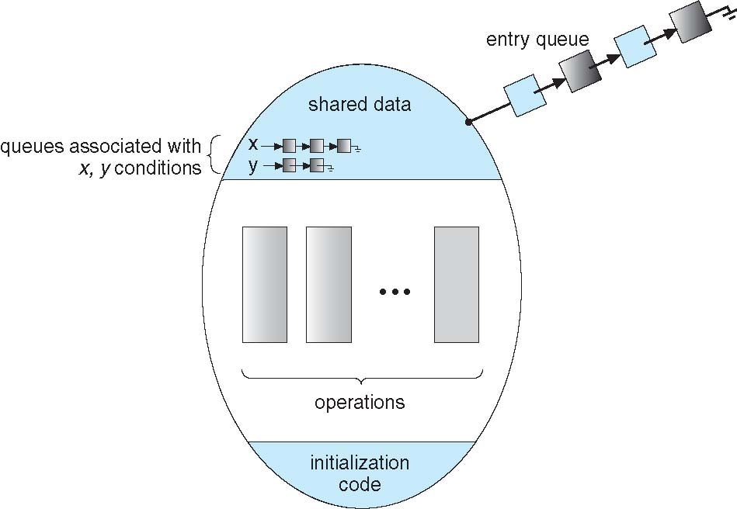
Monitor (with condition variables)

Slide 41
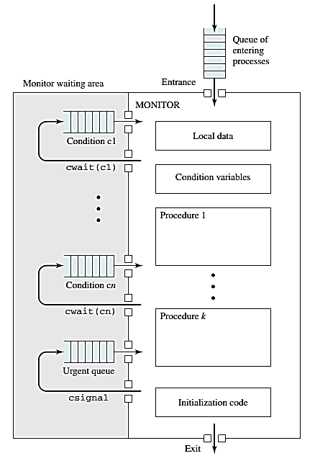
Structure of a Monitor

Slide 42
The dining-philosophers problem
monitor DiningPhilosophers
{
enum { THINKING; HUNGRY, EATING) state [5] ;
condition self [5];
void pickup (int i) {
state[i] = HUNGRY;
test(i);
if (state[i] != EATING) self[i].wait();
}
void putdown (int i) {
state[i] = THINKING;
// test left and right neighbors
test((i + 4) % 5);
test((i + 1) % 5);
}
void test (int i) {
if ((state[(i + 4) % 5] != EATING) &&
(state[i] == HUNGRY) &&
(state[(i + 1) % 5] != EATING) ) {
state[i] = EATING;
self[i].signal();
}
}
initialization_code() {
for (int i = 0; i < 5; i++)
state[i] = THINKING;
}
}

Slide 43
The dining-philosophers problem
DiningPhilosophers.pickup(i);
EAT
DiningPhilosophers.putdown(i);
Any problem?
No deadlock
Starvation is possible

Slide 44
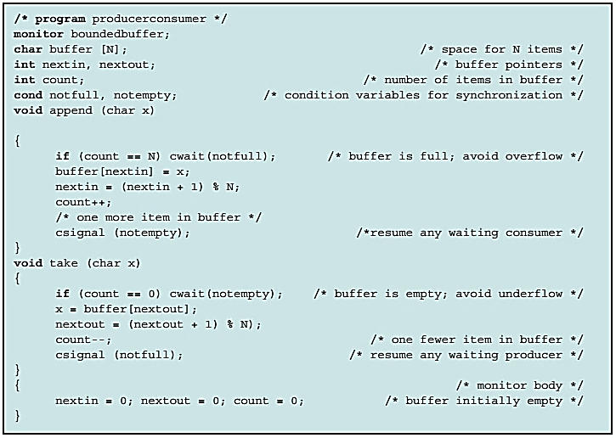
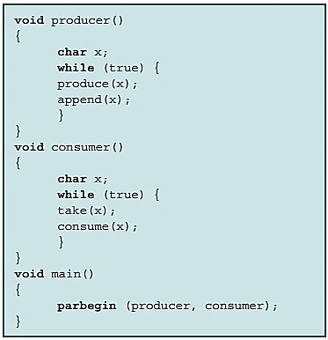
Solving bounded-buffer using a Monitor

Slide 45
Points to monitor
Monitors can be implemented by semaphores (See the textbook).
OSes support
Monitor, semaphore, spinlock, mutex
Examples
Solaris
Windows
Linux
Pthreads
Alternative approaches
Transactional Memory
OpenMP
Functional Programming Languages
void update(int value)
{
#pragma omp critical
{
count += value
}
}

Slide 46

Questions?

